Slide 1

DIGITAL DESIGN AND COMPUTER ORGANIZATION
Basic Operational Structure of computers T2: Chapter 1: 1.1-1.4
Department of Computer Science and Engineering

Slide 2
Functional Units of a Computer Basic Operational Concepts T2:Ch1 1.3
Review
Activity in a computer is governed by instructions.
To perform a task, an appropriate program consisting of a list of instructions is stored in the memory.
Individual instructions are brought from the memory into the processor, which executes the specified operations.
Data to be used as operands are also stored in the memory.

Slide 3
Functional Units of a Computer Basic Operational Concepts
An Instruction consists of two parts: An Operation code and operand/s.
OPCODE
OPERAND/S
Instruction
ADD MLOC, R0

Slide 4
Functional Units of a Computer Basic Operational Concepts
Execution steps: To add two operands
Step 1: Fetch the instruction from main memory into the processor
Step 2: Fetch the operand at location MLOC (memory location)from main
memory into the processor
Step 3: Add the memory operand (i.e. fetched contents of MLOC() to
the contents of register R0
Step 4: Store the resulting sum in R0 itself.
The original contents of R0 is overwritten.

Slide 5
Functional Units of a Computer Basic Operational Concepts
Prev example combines a memory access operation with an ALU operation
This can be realized as
Load LOCA,R1
Add R1,R0
Transfers b/w the memory and the cpu are started by sending the address of the location to memory unit and issuing the appropriate control signals

Slide 6
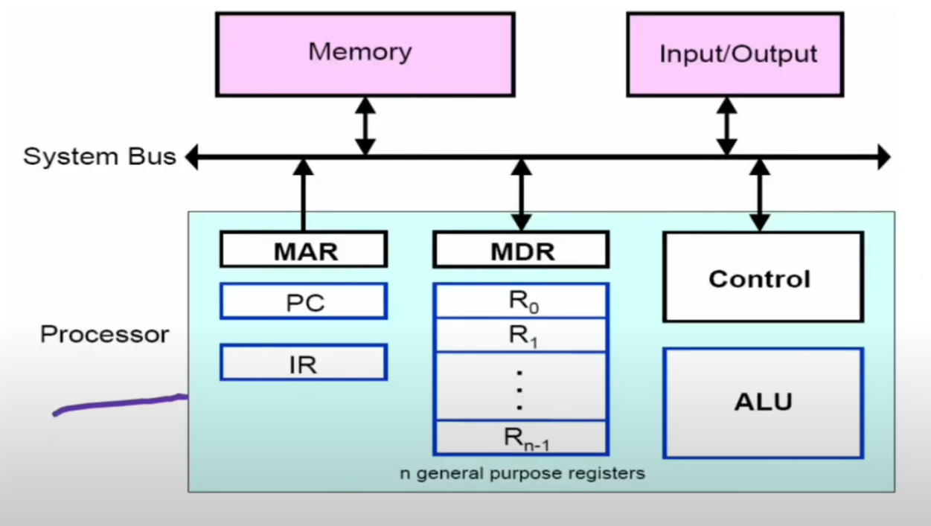
Functional Units of a Computer Basic Operational Concepts
Processor and Main Memory Interaction

Slide 7
Functional Units of a Computer Registers
What is a Register?
Definition: A register is a small, fast storage location within the CPU used to temporarily hold data and instructions during processing.
Key Characteristics:
Fast Access: Registers are the fastest form of memory, as they are located directly within the CPU.
Limited Size: Registers usually have a very small storage capacity, typically 32-bit or 64-bit, depending on the CPU architecture.
Temporary Storage: Used to store data temporarily for fast retrieval during computations.

Slide 8
Functional Units of a Computer Types of Registers
Instruction Register (IR)
Purpose: Temporarily holds the instruction currently being executed by the processor.
Function: Decodes the instruction, allowing the processor to understand and execute the required operation.
Program Counter (PC)
Purpose: Tracks the address of the next instruction to be executed in the program sequence.
Function: Automatically increments to point to the next instruction address after each execution.

Slide 9
Functional Units of a Computer Types of Registers
General-Purpose Registers (R0 – Rn-1)
Purpose: Temporarily store operands for quick access during instruction execution, supporting various operations like arithmetic and data transfer.
Function: Hold and manipulate data during calculations, minimizing memory access for faster CPU performance.
Memory Address Register (MAR)
Purpose: Holds the memory address of the location that the CPU is about to read from or write to.
Function: Communicates directly with the memory bus for fetching or storing data.

Slide 10
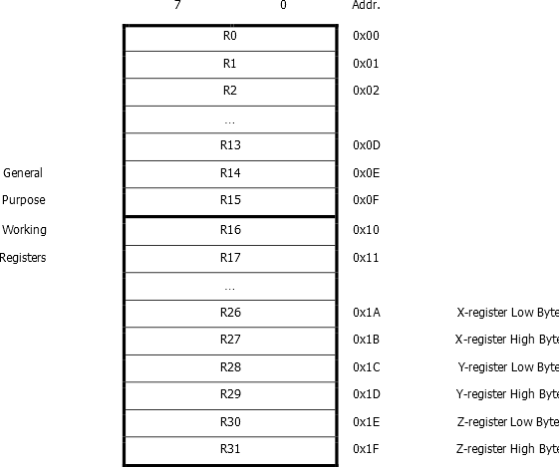
Functional Units of a Computer General Purpose Register
Notes:
The X,Y, Z-register is also a 16-bit register used for indirect addressing, but it is often employed specifically in functions like reading or writing to program memory (in some cases) and accessing memory data in general.

Slide 11
Functional Units of a Computer Types of Registers
Memory Data Register (MDR)
Purpose: Contains the actual data being transferred to or from the addressed memory location.
Function: Acts as a buffer between the CPU and memory.

Slide 12
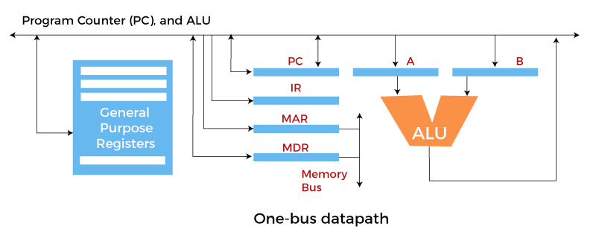
Functional Units of a Computer Basic Operational Concepts
Operational Steps Associated with Processor & Main Memory Interaction

Slide 13
Functional Units of a Computer Basic Operational Concepts
How is an instruction executed ?
A fetch-decode cycle is performed for each instruction in a program.
This means that every time the CPU needs to execute a new instruction, it goes through this cycle:
Fetch: The CPU retrieves the next instruction from memory using the program counter (PC).
Decode: The CPU interprets the instruction to determine what operation it needs to perform and what data it needs to use.
Execute: The CPU carries out the instruction, which might involve performing calculations, manipulating data, or controlling other parts of the computer.

Slide 14
Functional Units of a Computer Basic Operational Concepts
How is the next instruction executed ?
After the execution of an instruction, the PC is typically incremented to point to the next instruction in the program sequence, and the cycle repeats. This continuous process allows the CPU to execute a program's instructions one by one until the program is finished.
Let us now look at this process in detail.

Slide 15
Functional Units of a Computer Basic Operational Concepts
Programs reside in memory through input devices:
Programs are loaded into the computer's memory from input devices like keyboards or storage devices (e.g., hard drives, SSDs). This step typically happens before the program starts executing.
2. PC is set to point to the first instruction:
The Program Counter (PC) holds the address of the next instruction to be executed. At the start, it is initialized to point to the first instruction in the program.
3. The contents of PC are transferred to MAR:
The Memory Address Register (MAR) holds the address of the memory location that is being accessed. The address from the PC is copied to MAR.

Slide 16
Functional Units of a Computer Basic Operational Concepts
4. A Read signal is sent to the memory:
A signal is sent to the memory to indicate that data should be read from the address specified by the MAR.
5. The first instruction is read out and loaded into MDR:
The instruction located at the address in MAR is read from memory and placed into the Memory Data Register (MDR).
6. The contents of MDR are transferred to IR:
The Instruction Register (IR) holds the current instruction to be executed. The data in MDR (which is the fetched instruction) is transferred to IR.

Slide 17
Functional Units of a Computer Basic Operational Concepts
7. The instruction is ready to be decoded and executed:
The instruction in IR is decoded to understand what action needs to be performed.
8.If the instruction involves an operation to be performed by the ALU:
If the instruction requires arithmetic or logical operations, the necessary operands must be obtained.
Get operands:
General-purpose register: If the operands are in general-purpose registers, these registers are accessed directly.

Slide 18
Functional Units of a Computer Basic Operational Concepts
8.
Memory: If the operands are in memory, the following steps are performed:
The address of the operand is transferred to MAR.
A Read signal is sent to memory to fetch the operand.
The operand is read into MDR and then transferred to the ALU.
9.Perform operation in ALU:
The Arithmetic Logic Unit (ALU) performs the operation specified by the instruction using the operands it received.

Slide 19
Functional Units of a Computer Basic Operational Concepts
10.Store the result back:
To general-purpose register: If the result needs to be stored in a register, it is written to the appropriate general-purpose register.
To memory: If the result needs to be stored in memory:
The address for storing the result is transferred to MAR.
The result is placed in MDR.
A Write signal is sent to memory to store the result.
11.During the execution of the current instruction, PC is incremented to the next instruction

Slide 20
Functional Units of a Computer Interrupt
What is an interrupt ?
An interrupt is a request from an I/O device for service by the processor.
Why is an interrupt necessary?
Normal execution of programs may be interrupted if some device requires urgent servicing.
To deal with the situation immediately, the normal execution of the current program must be interrupted.

Slide 21
Functional Units of a Computer Procedure of interrupt operation
The I/O device raises an interrupt signal.
The processor provides the requested service by executing an appropriate interrupt-service routine.
The state of the processor is first saved before servicing the interrupt
Normally, the contents of the PC, the general registers, and some control information are stored in memory.
When the interrupt-service routine is completed, the state of the processor is restored so that the interrupted program may continue.

Slide 22
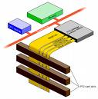
Functional Units of a Computer Bus Structures T2:Ch1 1.4
What is Bus ?
A bus is a collection of wires that connects different parts of a computer in an organized manner for the purpose of communicating information such as memory address, I/O address, Data, Control bits etc.
Why is a bus required ?
With the bus structure, speed of operation can be achieved since collection of wires in a bus permits for transferring all bits of information at a time i.e., in parallel. One byte or one full word at a time simultaneously on different wires.

Slide 23
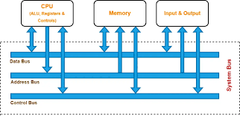
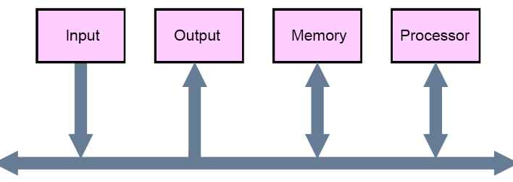
Functional Units of a Computer Bus Structures
A group of lines that serves a connecting path for several devices is called a bus
In addition to the lines that carry the data, the bus must have lines for address and control purposes
The simplest way to interconnect functional units is to use a single bus, as shown below

Slide 24
Functional Units of a Computer Bus Structures
Single-bus
Simplest way of interconnecting functional units.
All units are connected to this bus.
Can be used for only one transfer at a time, thereby only 2 units can actively use the bus at a time.
Low Cost and flexibility for attaching peripheral devices.

Slide 25
Functional Units of a Computer Bus Structures
Drawbacks of the Single Bus Structure
The devices connected to a bus vary widely in their speed of operation
Some devices are relatively slow, such as printer and keyboard
Some devices are considerably fast, such as optical disks
Memory and processor units operate are the fastest parts of a computer
Solutions
Efficient transfer mechanism is needed to cope with this timing problem
A common approach is to include buffer registers.
An another approach is to use two-bus structure and an additional transfer mechanism(One bus can be used to fetch instruction other can be used to fetch data, required for execution).

Slide 26
Functional Units of a Computer Buffer Register
Working :
The approach is to include buffer registers with the devices to hold the information during transfers which smoothes out the timing difference between the cpu,memory and i/o devices
A buffer register holds data temporarily. Buffer register compensate the timing differences among processor, memory and slow speed peripherals like Printer, Key-board, magnetic tape etc., during the transfers over a common communication path i.e., single bus.

Slide 27
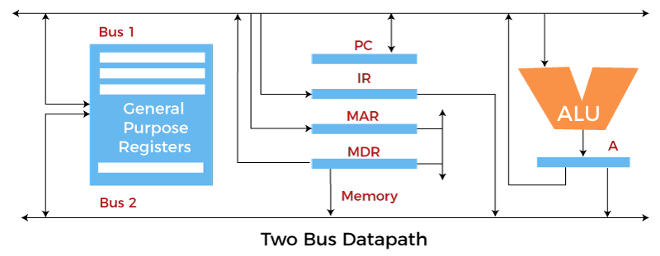
Functional Units of a Computer Two Bus Architecture

Slide 28
Functional Units of a Computer Two Bus Architecture
Two-Bus Structure and an additional transfer mechanism (One bus can be used to fetch instruction other can be used to fetch data, required for execution).
Working :
The approach is to include buffer registers with the devices to hold the information during transfers which smoothes out the timing difference between the cpu,memory and i/o devices
A buffer register holds data temporarily. Buffer register compensate the timing differences among processor, memory and slow speed peripherals like Printer, Key-board, magnetic tape etc., during the transfers over a common communication path i.e., single bus.

Slide 29
Functional Units of a Computer MCQ
Which of the following registers acts as a buffer between CPU and main memory?
a) Program Counter (PC)
b) Memory Address Register (MAR)
c) Memory Data Register (MDR)
d) Instruction Register (IR)

Slide 30
Functional Units of a Computer MCQ
Which of the following registers acts as a buffer between CPU and main memory?
a) Program Counter (PC)
b) Memory Address Register (MAR)
c) Memory Data Register (MDR)
d) Instruction Register (IR)
Answer: c) Memory Data Register (MDR)
Explanation: MDR holds the actual data being transferred to/from memory, acting as a buffer.

Slide 31
Functional Units of a Computer MCQ
The Program Counter (PC) of a processor contains 0x200. The instruction at 0x200 is a branch instruction to address 0x400. Assuming the branch is taken, what will be the content of the PC after the instruction is executed?
a) 0x200 b) 0x201 c) 0x400 d) 0x401

Slide 32
Functional Units of a Computer MCQ
The Program Counter (PC) of a processor contains 0x200. The instruction at 0x200 is a branch instruction to address 0x400. Assuming the branch is taken, what will be the content of the PC after the instruction is executed?
a) 0x200 b) 0x201 c) 0x400 d) 0x401
Answer: c) 0x400 Explanation: PC holds the address of the next instruction. For a branch instruction, if the branch is taken, the PC is loaded with the branch target (0x400).

Slide 33
Functional Units of a Computer MCQ
6. An interrupt in a computer system is best described as:
a) A request from an I/O device for immediate processor service b) A program error caused by division by zero c) A trap used to handle illegal instructions d) A buffer overflow condition

Slide 34
Functional Units of a Computer MCQ
An interrupt in a computer system is best described as:
a) A request from an I/O device for immediate processor service b) A program error caused by division by zero c) A trap used to handle illegal instructions d) A buffer overflow condition
Answer: a) A request from an I/O device for immediate processor service Explanation: Interrupts are signals raised by I/O devices to get urgent CPU service.

Slide 35
Functional Units of a Computer MCQ
Which of the following is a major drawback of the single-bus structure in computer organization?
a) High cost of connecting devices b) Only one transfer at a time is possible c) Difficult to attach peripheral devices d) Requires multiple buffer registers

Slide 36
Functional Units of a Computer MCQ
Which of the following is a major drawback of the single-bus structure in computer organization?
a) High cost of connecting devices b) Only one transfer at a time is possible c) Difficult to attach peripheral devices d) Requires multiple buffer registers
Answer: b) Only one transfer at a time is possible Explanation: A single bus allows only two devices to communicate at a time, creating bottlenecks.

Slide 37
THANK YOU
Team DDCO
Department of Computer Science

